Slide 1


Multinational Newborn Screening Research
Data Visualization Dashboard

Slide 2
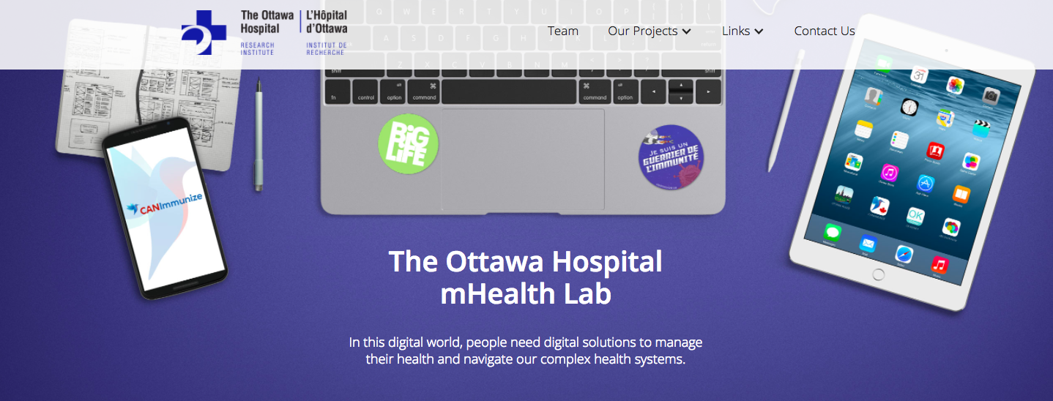

Slide 3
mHealth Lab

Slide 4
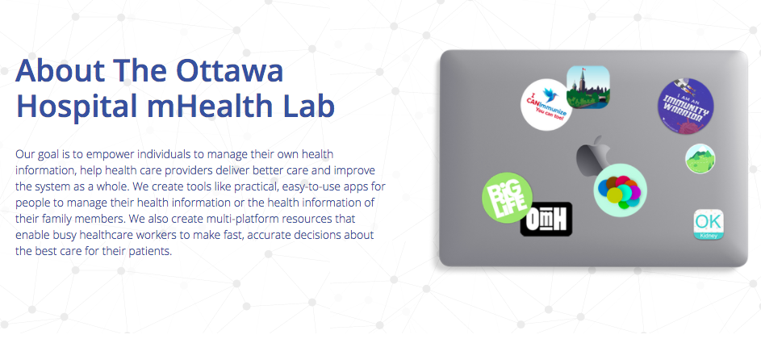
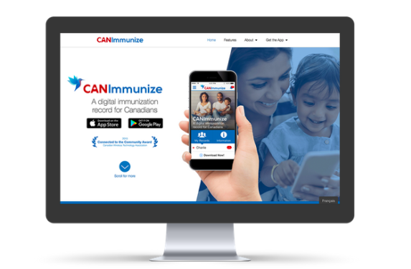
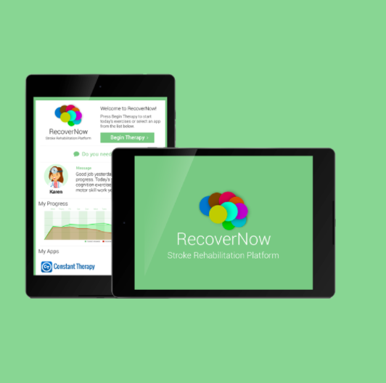




About The Ottawa Hospital mHealth Lab
Our goal is to empower individuals to manage their own health information, help health care providers deliver better care and improve the system as a whole. We create tools like practical, easy-to-use apps for people to manage their health information, or the the health information of their family members. We also create multi-platform resources that enable busy healthcare workers to make fast, accurate decisions about the best care for their patients.

Slide 5
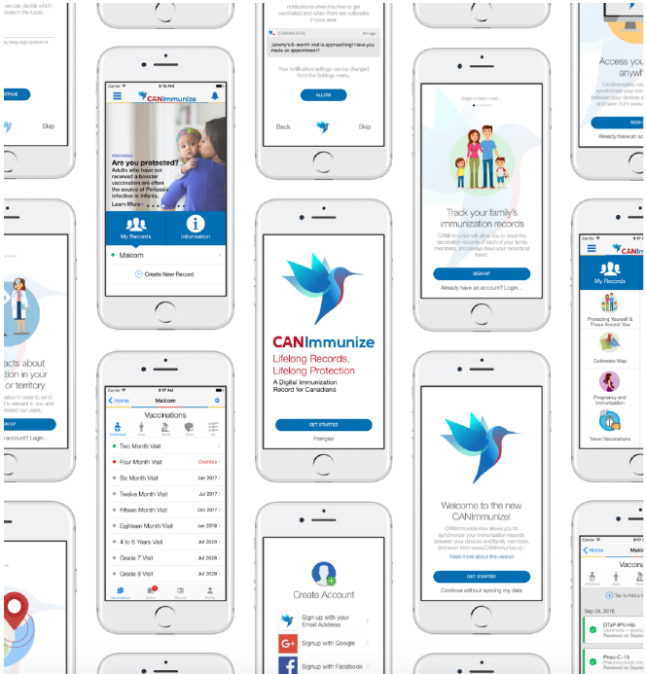

Slide 6
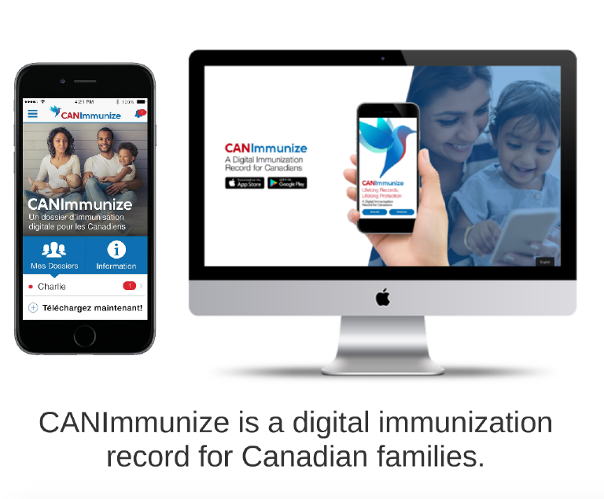
A digital immunization record for Canadians

Slide 7
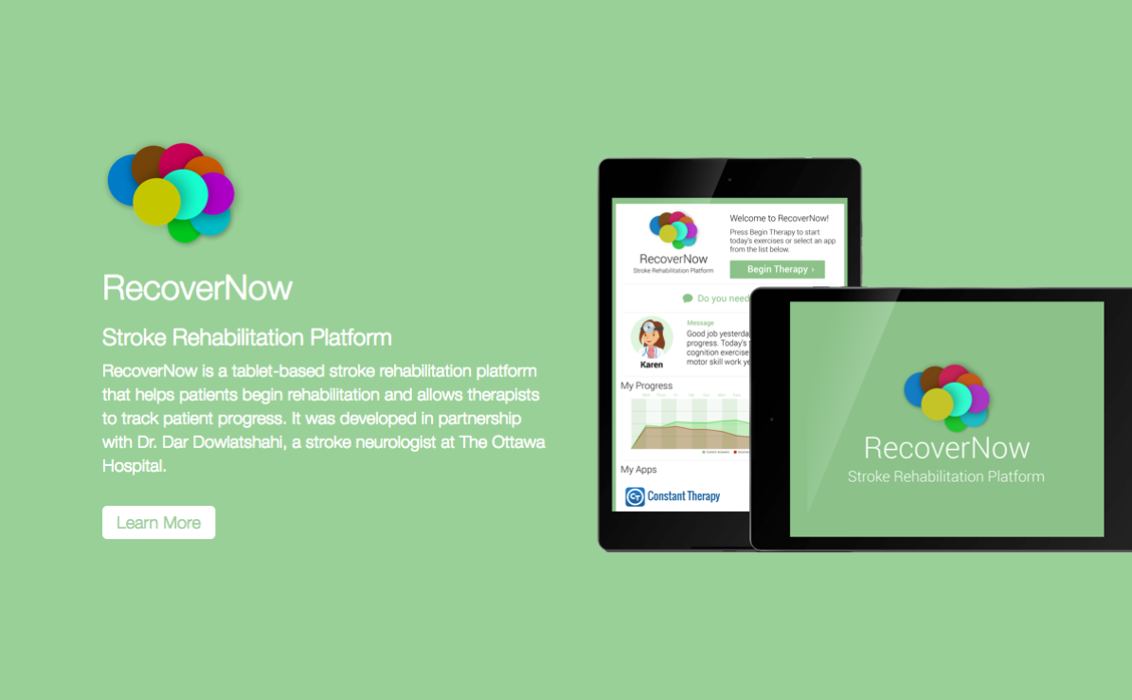

Slide 8
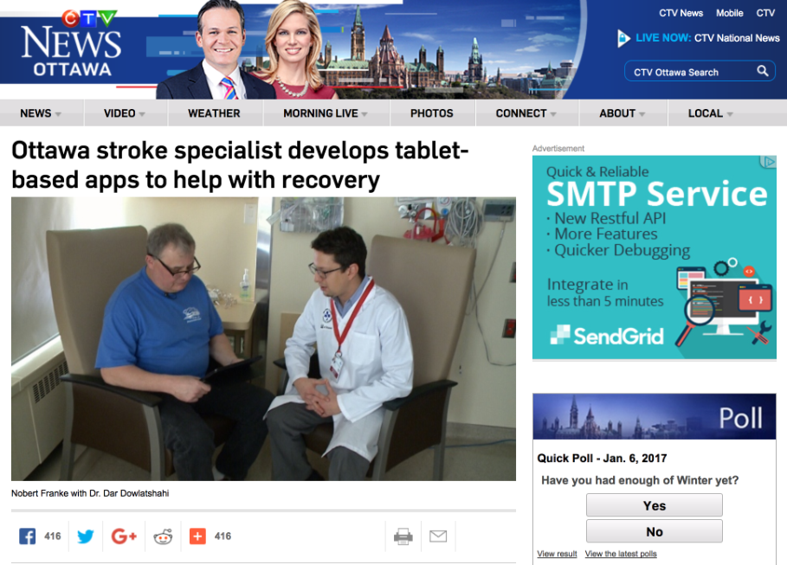

Slide 9
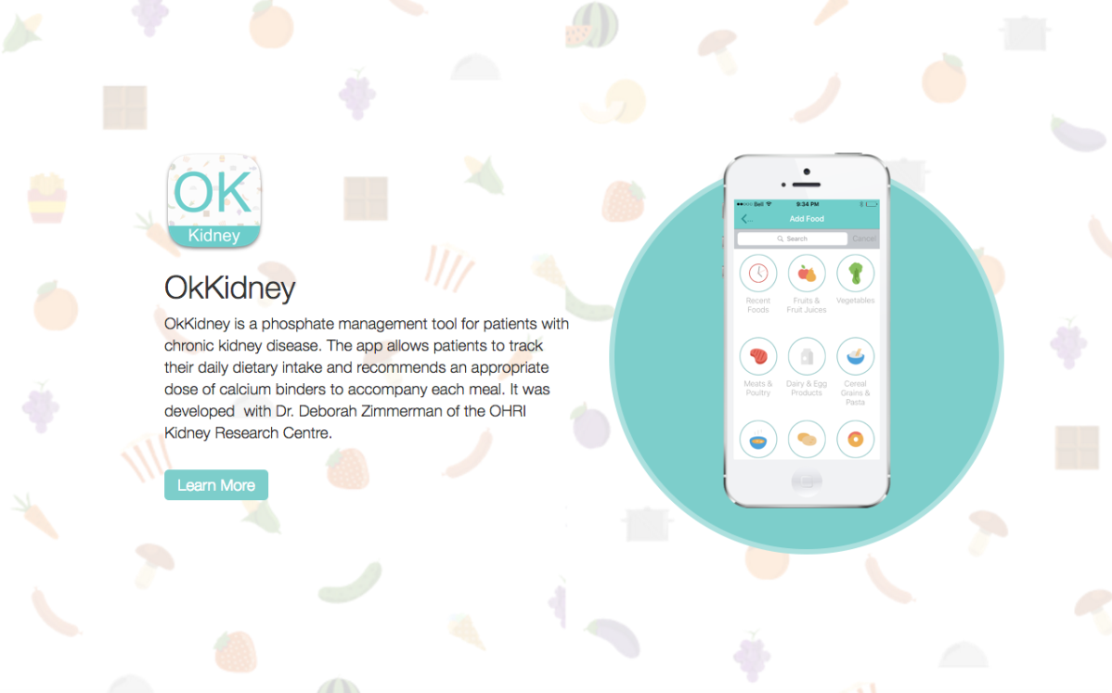

Slide 10
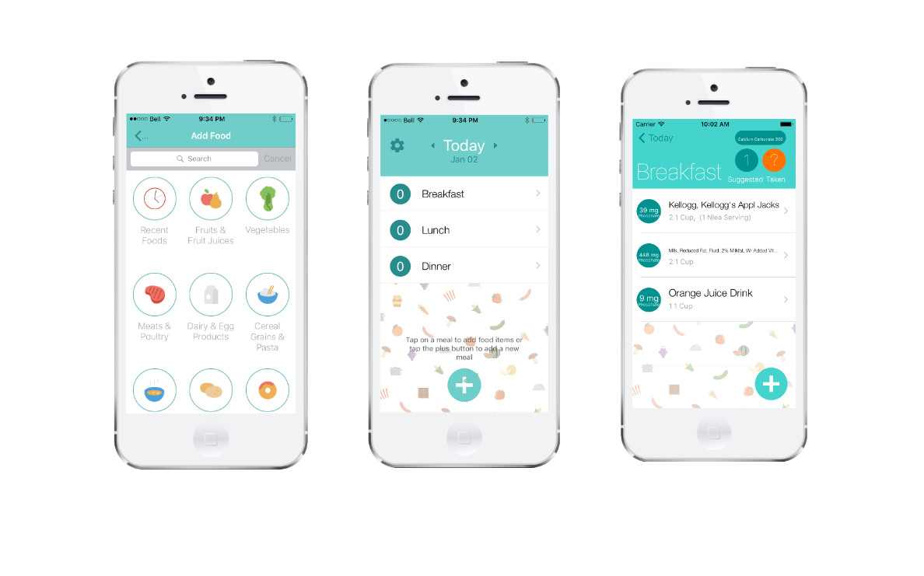

Slide 11


Slide 12


Slide 13
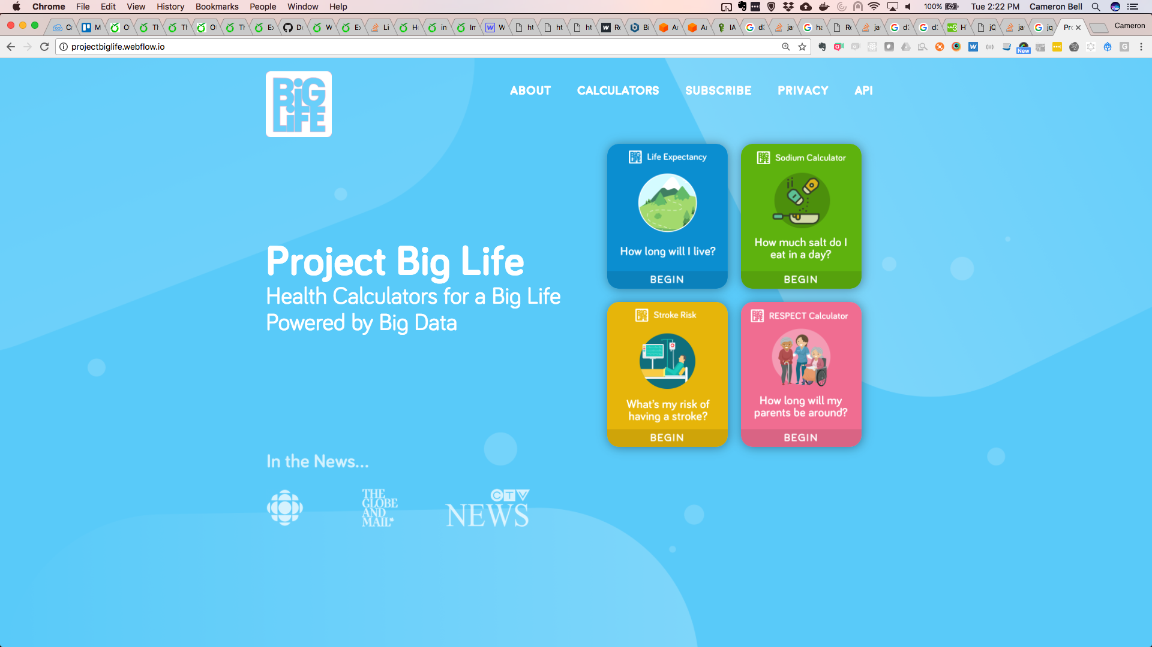

Slide 14


Slide 15
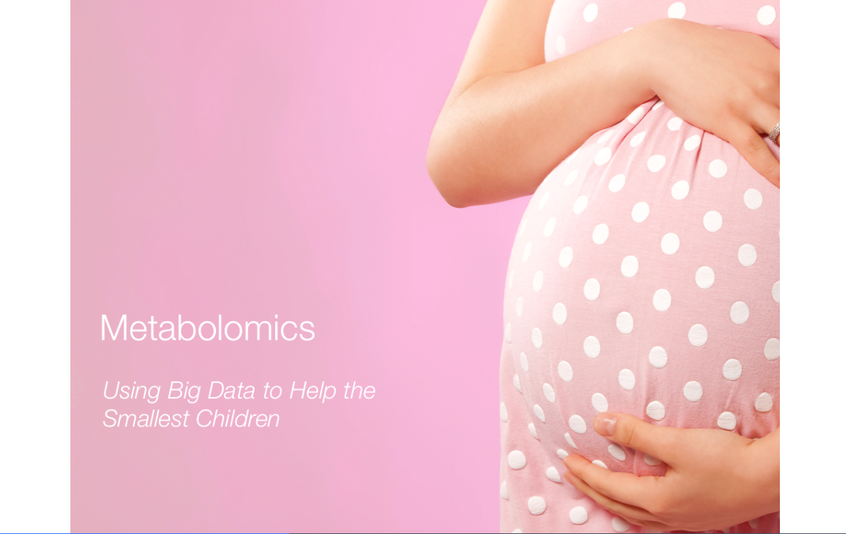

Slide 16

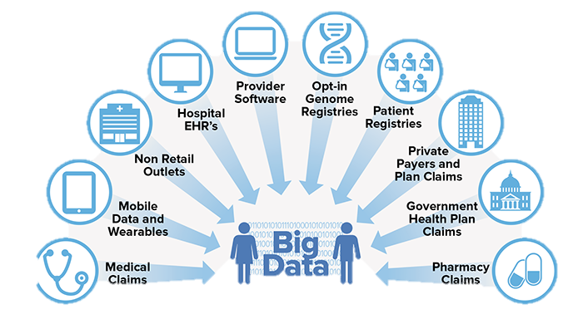
Inform policy | Evaluate Programs | Track population trends

Slide 17
All newborns in Ontario, Canada
30 inherited, treatable diseases
Amounting to over 145, 000 infants annually

Slide 18

Health care professionals educate families about newborn screening
Wait until ideal window of time to take newborn sample
Small sample is taken from newborn heel

Slide 19
Sample is applied to newborn screening card
Sample is sent to newborn screening laboratory

Slide 20
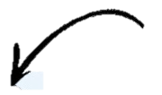
Screen Positive Patients notified
A
B
C
Sample is punched, analyzed and a newborn record generated

Slide 21
Demographic data
sex, birthweight, gestational age
Newborn screening data
Hormones
Amino acids
Metabolic Data
Genetic results
Clinical Results
Disease positive
Disease negative
Newborn Screening Record

Slide 22
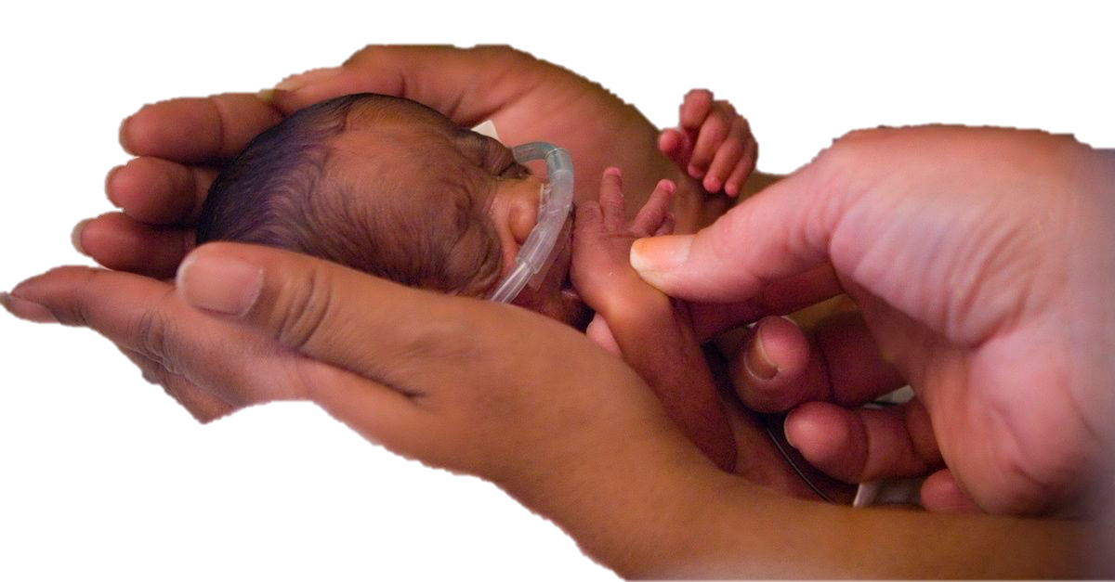
Looking at biological fingerprints
To build and test biological algorithms from health data to predict early childhood health outcomes
Small for gestational age
Inborn errors of metabolism
Neonatal death
Pediatric kidney disease
Neonatal sepsis
Preterm
Hormonal disorders
Birth asphyxia
Genetic conditions

Slide 23
“OUR GOAL: to ensure that women and newborns survive and remain healthy during pregnancy and childbirth and to improve health outcomes for young children.”

Slide 24




Matlab, Bangladesh
Shanghai, China
Manila, The Philippines
Lusaka, Zambia

Slide 25
2 new sites
in sub-Saharan Africa
Matlab, Bangladesh
Shanghai, China
Manila, The Philippines
Lusaka, Zambia
2 new sites
in south Asia

Slide 26


International Newborn Cohorts
Blood Spot
Collection
Samples to
NSO
Validation
Sample Analysis
Clinical Reporting

Slide 27
One sample…..
…..over 120 data points
Clinical Results
Newborn screening data
Sample quality data
Demographic data

Slide 28
How many records do we have?
…. and counting!
The Philippines | …… | ~90 000
Shanghai, China | …… | ~5 000
Matlab, Bangladesh | …… | ~1 500
Lusaka, Zambia | …… | ~ 500

Slide 29
What do we need?
Data visualization dashboards to permit easy interaction with our multinational datasets. Dashboards will be used to:
provide our team with an aggregate view of the current state of our projects
communicate progress and aggregate analytics back to our stakeholders in their respective countries

Slide 30
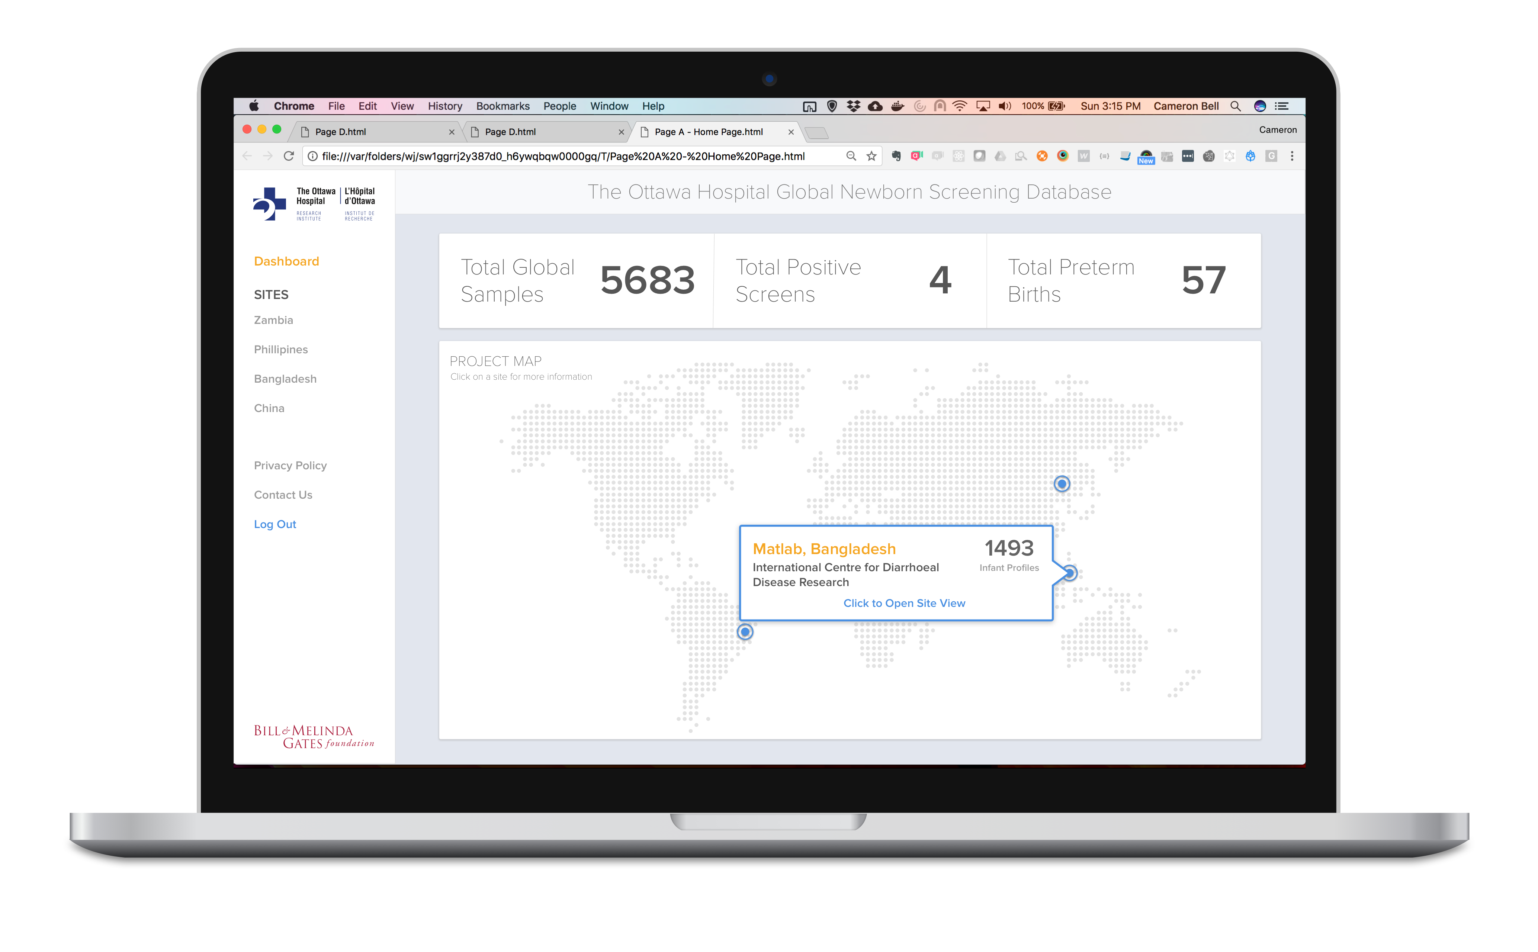
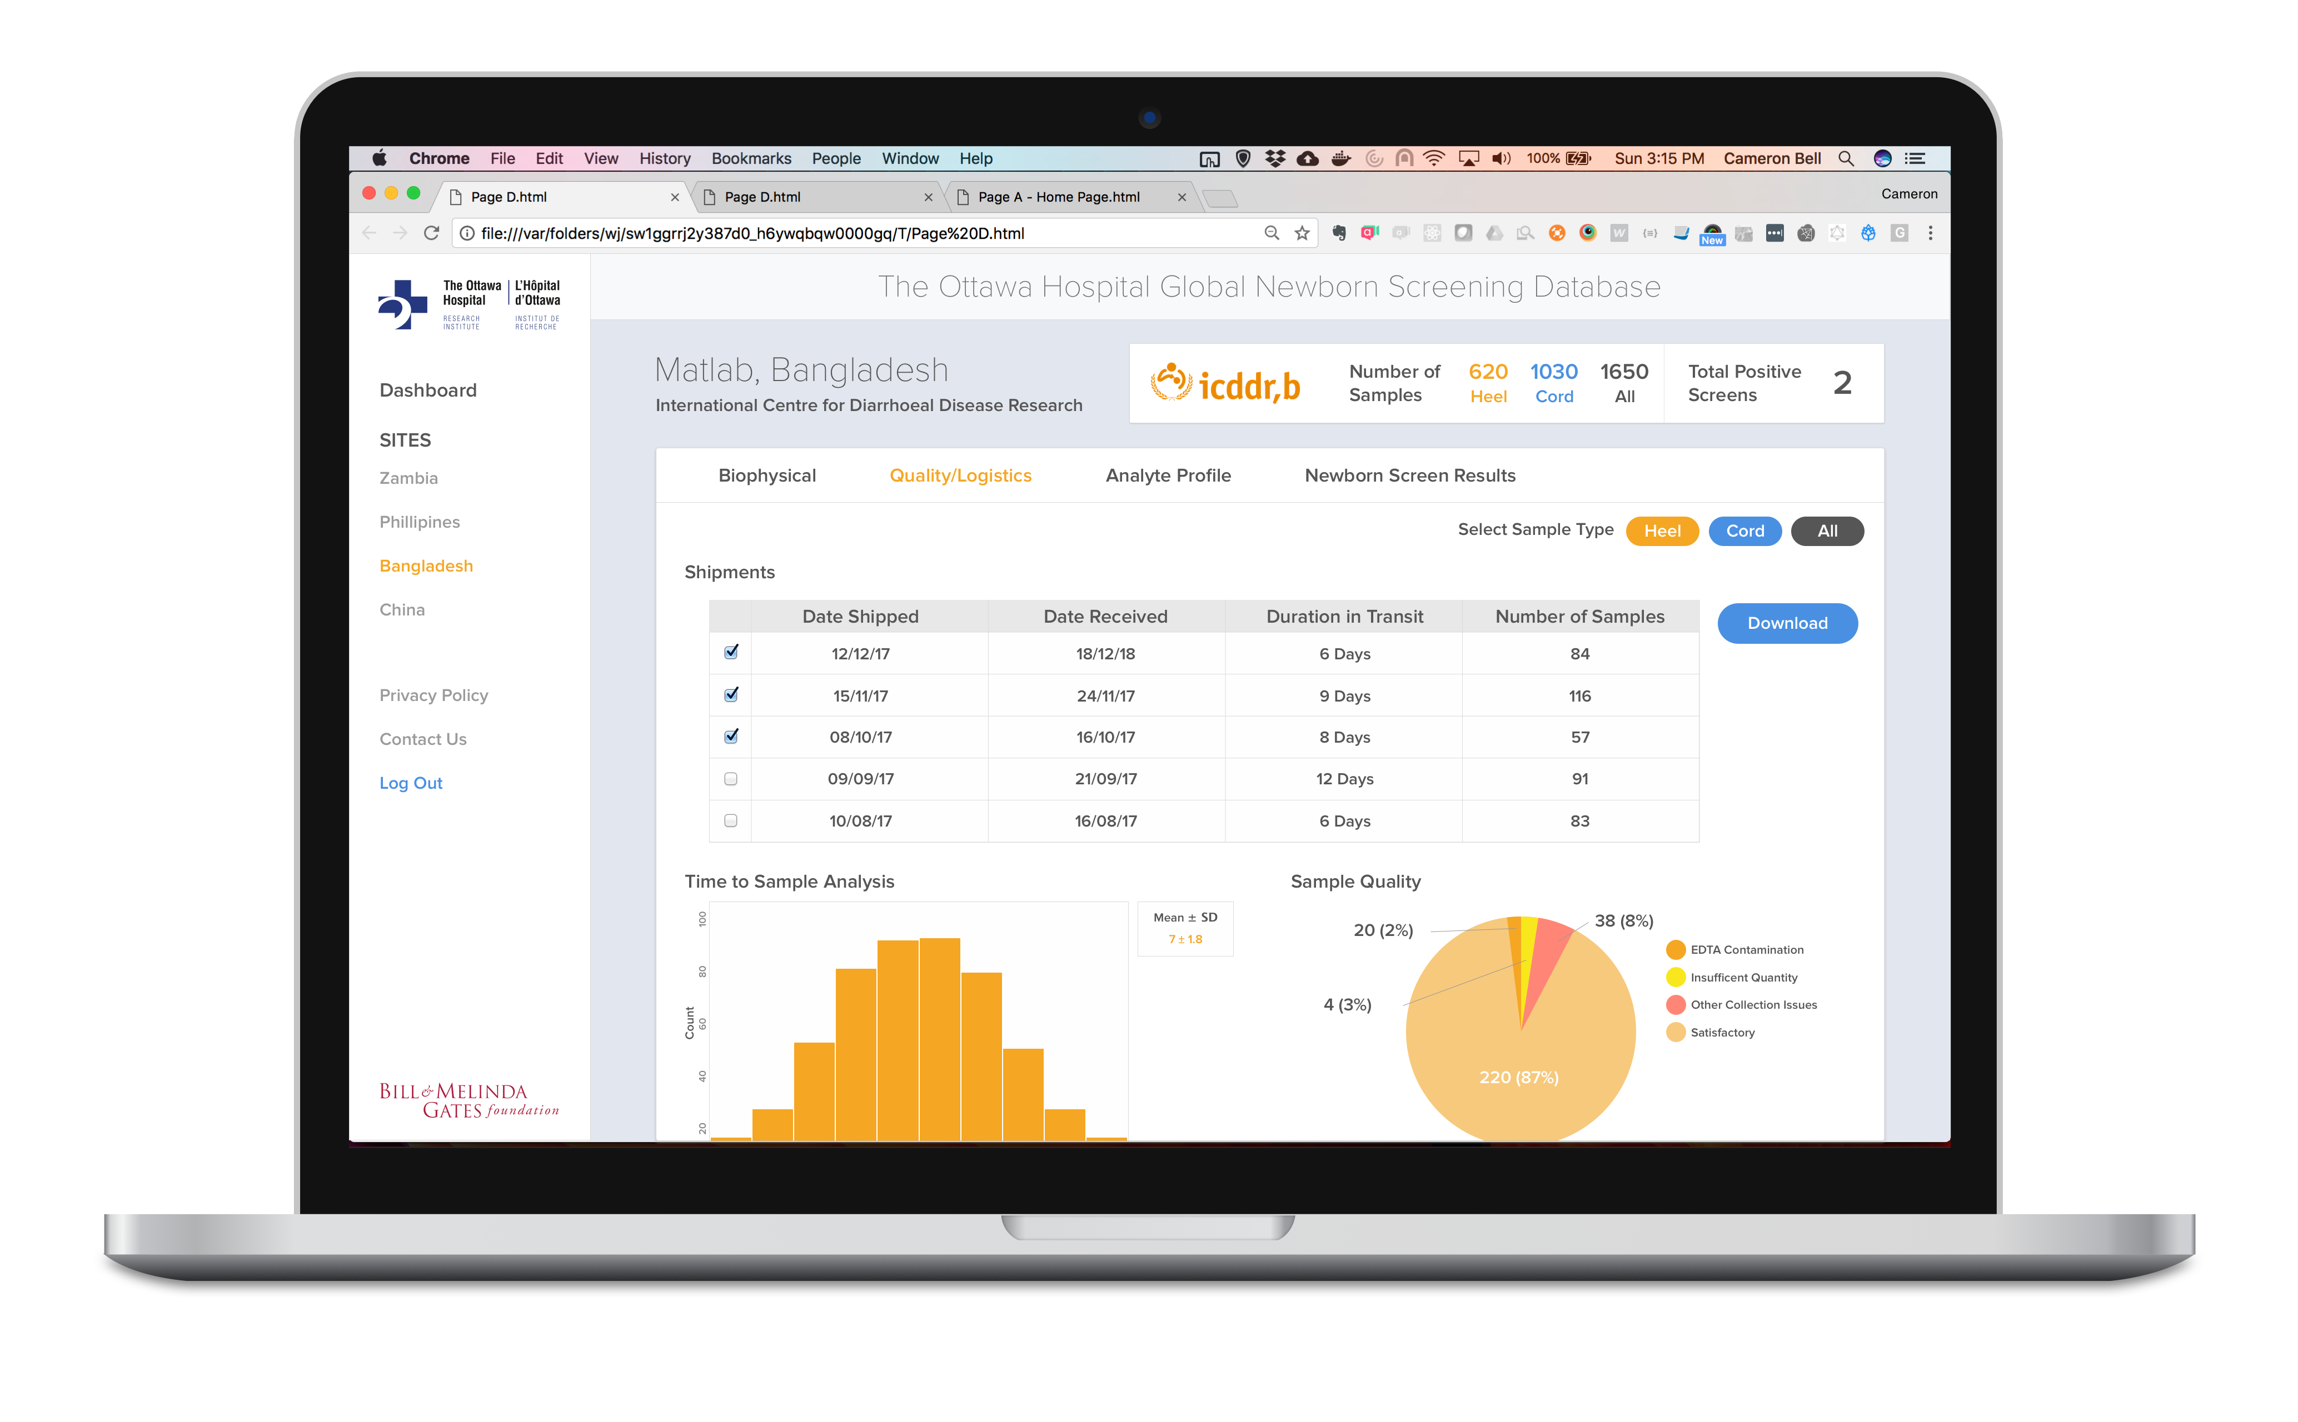

Slide 31



Thank you!
from

